Slide 1

MORIS User Guide
Table of Contents
Introduction……………………………………………………………………………………………………………………………… 2
Getting Started…………………………………………………………………………………………………………………………… 3
Tools……………………………………………………………………………………………………………………………………... 4
Adding Data Layers……………………………………………………………………………………………………………………… 6
Adding Data Layers by Searching……………………………………………………………………………………………………….. 7
Data Layers with Scale Dependencies…………………………………………………………………………………………………... 8
Reordering Data Layers……………………………………………………………………………………………………………….... 9
Navigating the Map…………………………………………………………………………………………………………………….. 10
Customizing Data Layers………………………………………………………………………………………………………………. 12
Customizing the Map…………………………………………………………………………………………………………………... 13
Removing Data Layers…………………………………………………………………………………………………………………. 14
Viewing Metadata………………………………………………………………………………………………………………………. 15
Searching for a Location……………………………………………………………………………………………………………….. 16
Identifying Features…………………………………………………………………………………………………………………….. 18
Measuring Length or Area…………………………………………………………………………………………………………….... 20
Bookmarking/Sharing a Map…………………………………………………………………………………………………………... 21
Downloading Data……………………………………………………………………………………………………………………… 22
Printing and Saving a Map Image……………………………………………………………………………………………………… 26
Editing Data…………………………………………………………………………………………………………………………….. 27
MuniMapper on a MAC…………………………………………………………………………………………………………........... 30
Abutters List Tool……………………………………………....…………………………………………………………………......... 30
Parcel Data Filter Tool……………………………………………....…………………………………………………………………. 33
Problems? Questions? Comments?.……………………………………………………………………………………………………. 39
.

Slide 2

Introduction
Background
Municipal Mapper (Muni Mapper for short) is a mapping tool created by the Office of Geographic Information (MassGIS). Muni Mapper provides access to a selection of map information from MassGIS’ statewide repository that is specifically relevant to cities and towns. Muni Mapper provides basic capabilities for displaying, searching, and sharing map information relevant to municipalities. Users can also download data for use in a Geographic Information System (GIS).
What do I need to run Muni Mapper?
Muni Mapper is run through a web browser. At this time, Muni Mapper fully works in Google Chrome, Internet Explorer, Mozilla Firefox, and Safari. The latest versions of these browsers are recommended. Currently Google Chrome 27, Internet Explorer 10, Mozilla Firefox 21, and Safari 5.1.7 have been thoroughly tested, but the application also works in older versions of these browsers.
Some Muni Mapper tools and layers are not available for every municipality.
Muni Mapper is derived from a similar on-line mapping tool called MORIS, the Massachusetts Ocean Resource Information System. MORIS was created by the Massachusetts Office of Coastal Zone Management (CZM), the Office of Geographic Information (MassGIS), SeaPlan (formerly Massachusetts Ocean Partnership), Applied Science Associates (ASA), Charlton Galvarino, and PeopleGIS.
Back to Table of Contents

Slide 3
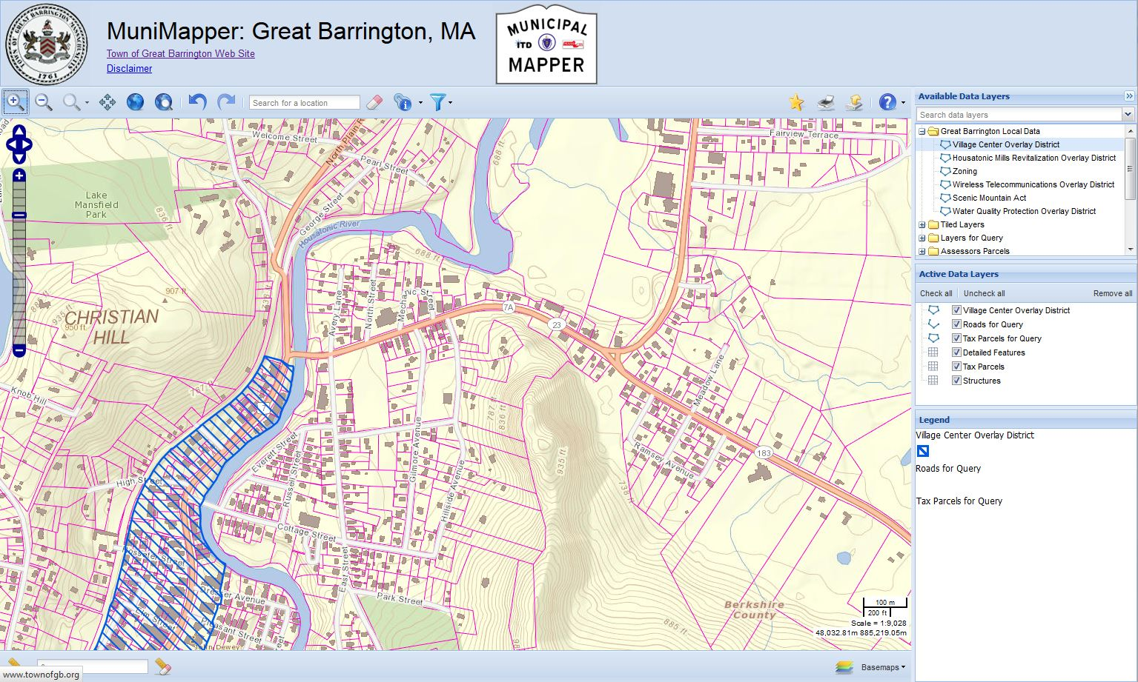
Getting Started
To start Muni Mapper, go to a specific town such as: http://maps.massgis.state.ma.us/map_ol/great_barrington.php
Initial view of the Muni Mapper application
Please note: Not all tools and layers are available for all municipalities.
Tools
Available Data layers
Active Data layers
Map view
Legend
Tools
Back to Table of Contents
Settings

Slide 4
Tools – Please note: Not all tools are available for all municipalities.
Zoom in. Click this button then click on the map to zoom in to an area, or click on the map, hold down the mouse button, and drag to draw a box to zoom in to that area of interest. The box will be outlined in red as you draw it.
Zoom out. Click this button then click on the map to see approximately twice as much area, or click on the map, hold down the mouse button, and drag to draw a box to zoom out from that box. The box will be outlined in red as you draw it.
Zoom to scale. Click this button to view a drop-down menu. Click one of the listed common map scales, or to zoom to an exact scale, enter a scale value (e.g., 7,500) into the “Custom scale” box. Press Enter to zoom to that scale. This tool is only available in the custom basemap.
Pan. Click this button then click on the map, hold down the mouse button, and drag to recenter the map.
Zoom to initial extent. Click this button to zoom to the original statewide map extent.
Zoom to full extent of active data layers. Click this button to zoom to the extent of all the active data layers that are checked.
Go back to previous extent. Click this button to go back to the previous map extent.
Go to next extent. Click this button to go forward to the next map extent.
Search for a location. Type an address or location into the box and press Enter to zoom to a location. This location feature is provided by Microsoft Bing.
Clear location. Click this button to clear the location search results (a blue balloon marker or blue rectangle) from the map.
Pick a Municipality. Pick from the dropdown list, or start typing a city or town name and select the name to zoom to that municipality. (only the 351 municipalities are listed, not villages, sections, or neighborhoods-use the search for location window for these location types.)
Abutters List Tool. Create an abutters list from the parcel data. The abutters list will include the owner names and mailing addresses of the parcels with a certain configurable distance.
Parcel Data Filter Tool. Filter the parcel data by town or multiple towns, property type, total value (land + bldg.), bldg. value, last sale date, last sale price and lot size.
Permalink. Click this button to make a permalink for the map. Right-click the blue “permalink” and copy and save it as a bookmark to launch the Muni Mapper application with the current map settings (data layers, extent, etc.) enabled.
Print or save your map and legend. Click this button then enter a title and click the “OK” button to print or save images of your map and legend. A new pop-up window will appear. Right-click the blue “here” to open a new browser window containing your map and legend as separate images. You can save the images locally or use the browser print option to print the entire map.
Export data. Click this button to launch the data export wizard. This wizard may be used to download geospatial data as shapefiles, Google Earth files (KMLs), or GeoTIFFs.
Help. Click this button to view a drop-down menu. Click “Help HTML” to view the user guide in HTML. Click “Help PDF” to view a PDF document of the user guide. Click “About MuniMapper” to learn more about MuniMapper.
Please note: Not all tools are available in all viewers.
Back to Table of Contents

Slide 5
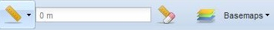
Tools (continued)
Measure by length or area. Click this button to view the measure menu. Move the mouse cursor over “Units” to view a menu of measurement units options and click one of the listed units to select that unit of measurement. Click “By length” to measure the length of a line, click on the map to draw vertices of the line, and double-click to finish drawing the line. Click “By area” to measure the area of a polygon, click on the map to draw vertices of the polygon, and double-click to finish drawing the polygon.
Clear measurement. Click this tool to clear the measured line or polygon from the map and to clear the distance or area from the measurement results box.
Basemaps. Click this tool to change the basemap or the opacity of the basemap (except custom —the opacity of any custom basemap is controlled data layer by data layer in the “Active Data Layers” window).
Please note: Not all tools are available for all municipalities.
Back to Table of Contents

Slide 6
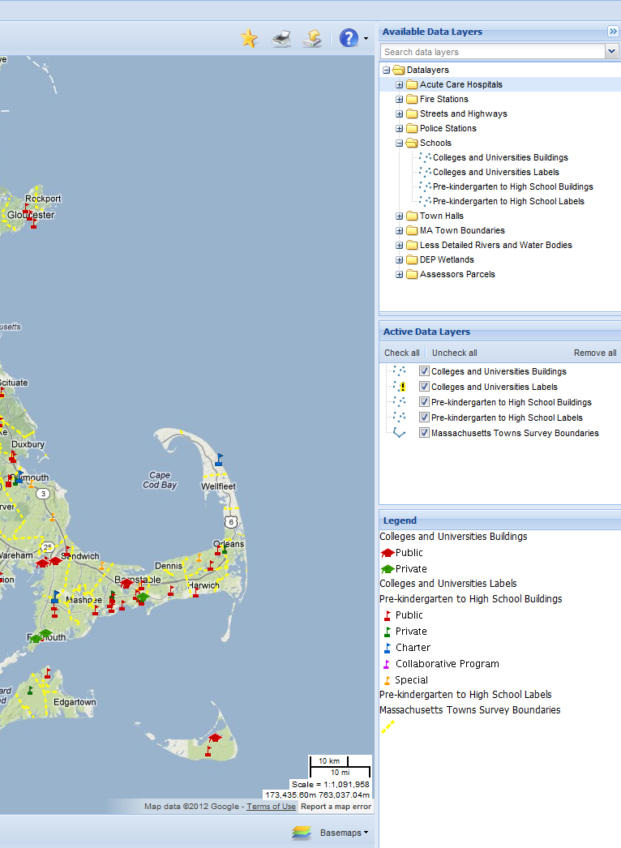
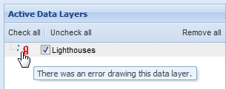
Adding Data Layers
1. Browse folders in the “Available Data Layers” window for data layers.
2. Click a data layer name to add it to the map, or right-click a data layer name and select “Add layer.” To add a folder of data layers, right-click a folder name and select “Add folder.”
3. The data layer is drawn on the map. The data layer name will appear in the “Active Data Layers” window and the legend of the data layer will be added to the “Legend” window.
Please note: If there is an error drawing a data layer, the data layer’s icon in the “Active Data Layers” window will have a red exclamation point. This red exclamation point indicates that the data layer is currently unavailable; this may be due to an internet connection or a web services problem. Changing the map extent (e.g., panning), adding data layers, etc., will cause the data link to be refreshed. If this connection is restored, the red exclamation point will go away.
Back to Table of Contents

Slide 7
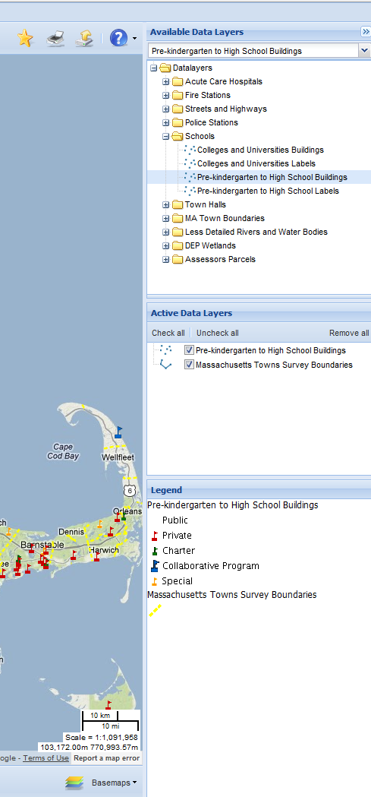
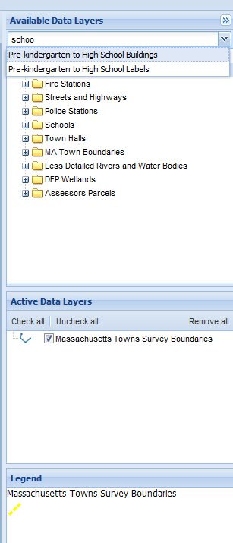
Adding Data Layers by Searching
1. Type a search keyword in the “Search data layers” box in the “Available Data Layers” window. The application searches data layer names and lists all data layers with that term in the title.
2. Click the data layer name of interest.
3. The data layer is drawn on the map. The folders in the “Available Data Layers” window will open to the first listing of the data layer. The data layer name will appear in the “Active Data Layers” window and the legend will be added to the “Legend” window.
Back to Table of Contents

Slide 8
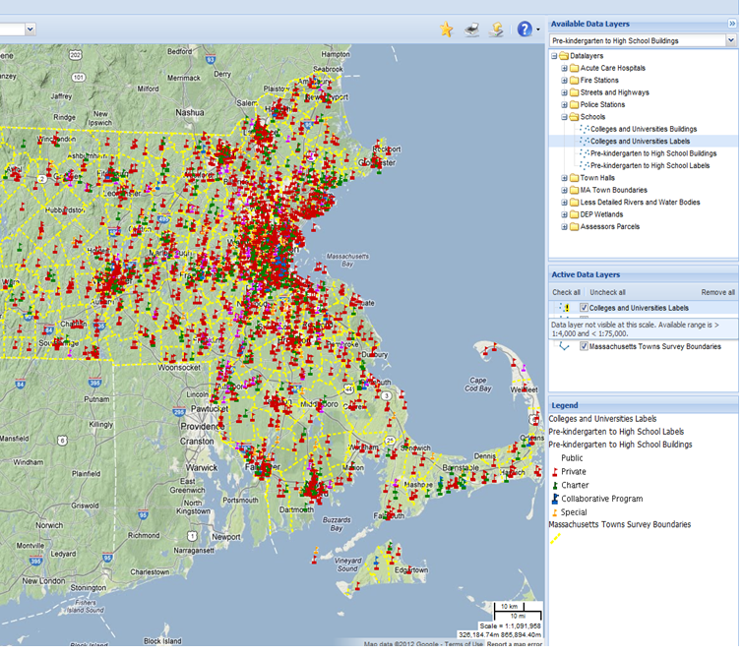
Data Layers with Scale Dependencies
Most data layers are visible at all scales, but some data layers have scale dependencies and are only visible within certain scale ranges, such as less than 1:100,000. If a data layer has a scale dependency and the map is not within the appropriate scale range, the data layer will not draw on the map and its icon in the “Active Data Layers” window will have a yellow exclamation point. Hover the mouse over the yellow exclamation point to see the range within which the data layer will draw. To view the data layer, zoom in or out to a map scale within the available scale range.
Back to Table of Contents

Slide 9
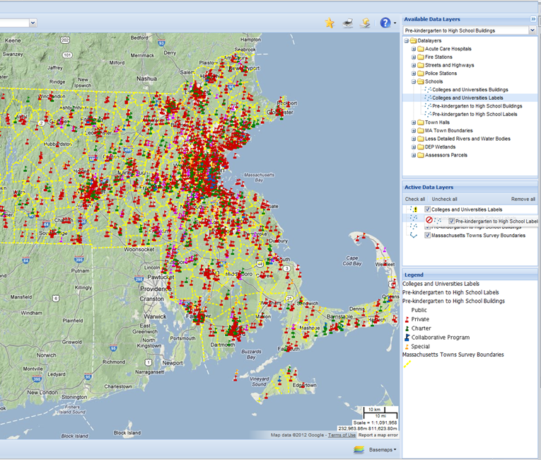
Reordering Data Layers
Data layers are drawn from the bottom to the top of the “Active Data Layers” list as they are added. To reorder the data layers, click on a data layer name in the “Active Data Layers” window, hold down the mouse button, and drag the data layer name up or down in the list to reorder how it is drawn in your map.
Back to Table of Contents

Slide 10
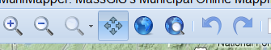
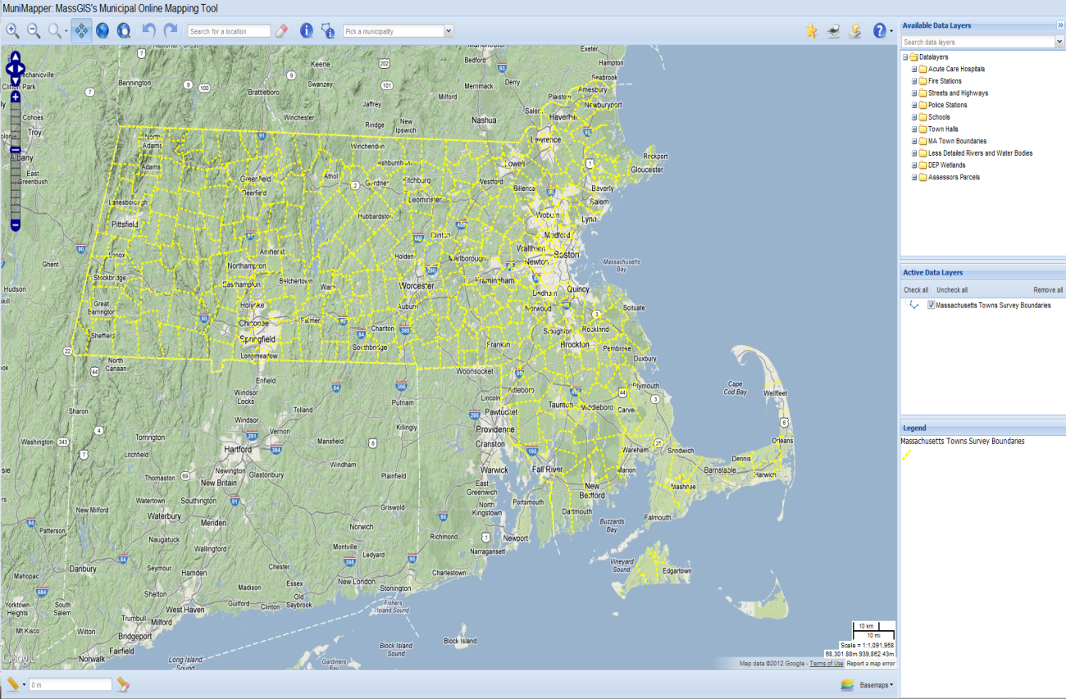
Navigating the Map
Zoom in. Click this button then click on the map to zoom in to an area, or click on the map, hold down the mouse button, and drag to draw a box to zoom in to that area of interest. The box will be outlined in red as you draw it.
Zoom out. Click this button then click on the map to see approximately twice as much area, or click on the map, hold down the mouse button, and drag to draw a box to zoom out from that box. The box will be outlined in red as you draw it.
Pan. Click this button then click on the map, hold down the mouse button, and drag to recenter the map.
Zoom to initial extent. Click this button to zoom to the original map extent provided when MORIS is first opened.
Zoom to full extent of active data layers. Click this button to zoom to the extent of all the active data layers that are checked.
Go back to previous extent. Click this button to go back to the previous map extent.
Go to next extent. Click this button to go forward to the next map extent.
Back to Table of Contents

Slide 11
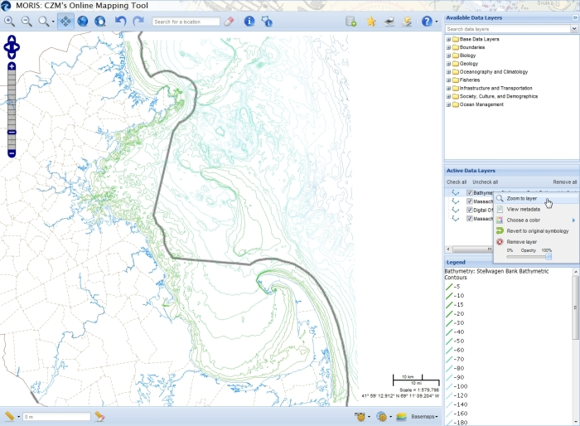
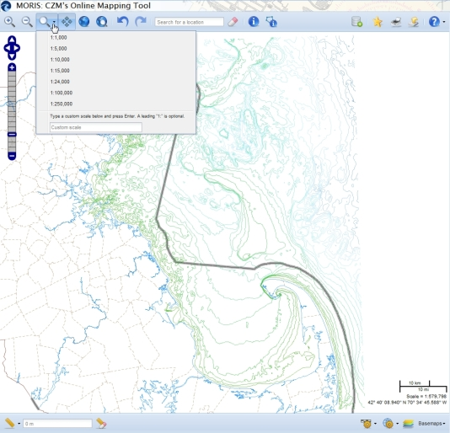
Navigating the Map (continued)
The “Zoom to scale” menu is only available when only MassGIS data is drawn. The Bing, CloudMade, Google, OpenStreetMap, and TopOSM basemaps may only be viewed at fixed zoom levels so this tool is greyed out when they are added. The custom basemap,with only MassGIS data, may be zoomed to any scale from 1:100 to 1:5,000,000. To zoom to a particular scale in the custom basemap, click the “Zoom to scale” button to view a drop-down menu. Select one of the listed scales or type a scale into the “Custom scale” box and press Enter.
The arrows may be used to pan the map. Click an arrow to pan the map north, south, east, or west.
The zoom slider may be used to zoom in or out on the map. Click the plus sign to zoom in one level on the center of the map or the minus sign to zoom out. To zoom in or out multiple zoom levels, drag the zoom slider up or down, and release the mouse button at the desired zoom level.
To zoom to the extent of a data layer, right-click the data layer name in the “Active Data Layers” window and select “Zoom to layer.”
Back to Table of Contents

Slide 12
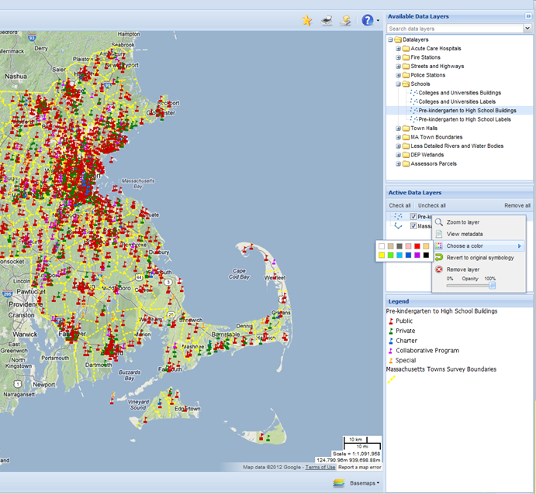
Customizing Data Layers
Symbology: The symbology of point, line, or polygon active data layers may be changed. Right-click a data layer’s name in the “Active Data Layers” window, move the mouse cursor over “Choose a color” to view a menu of color options, and click one of the colors. Points will be drawn as squares in the color you selected, lines will be drawn with the color you choose, and polygons will be drawn with a gray outline and filled in with the color you picked. To change back to the original symbology, right-click a data layer’s name in the “Active Data Layers” window and click “Revert to original symbology.”
Opacity: The opacity of active data layers may be changed. Right-click a data layer’s name in the “Active Data Layers” window, click the opacity slider, hold down the mouse button, and drag the slider to the desired opacity. Data layers with 0% opacity will be completely transparent and data layers with 100% opacity will be opaque.
Back to Table of Contents

Slide 13
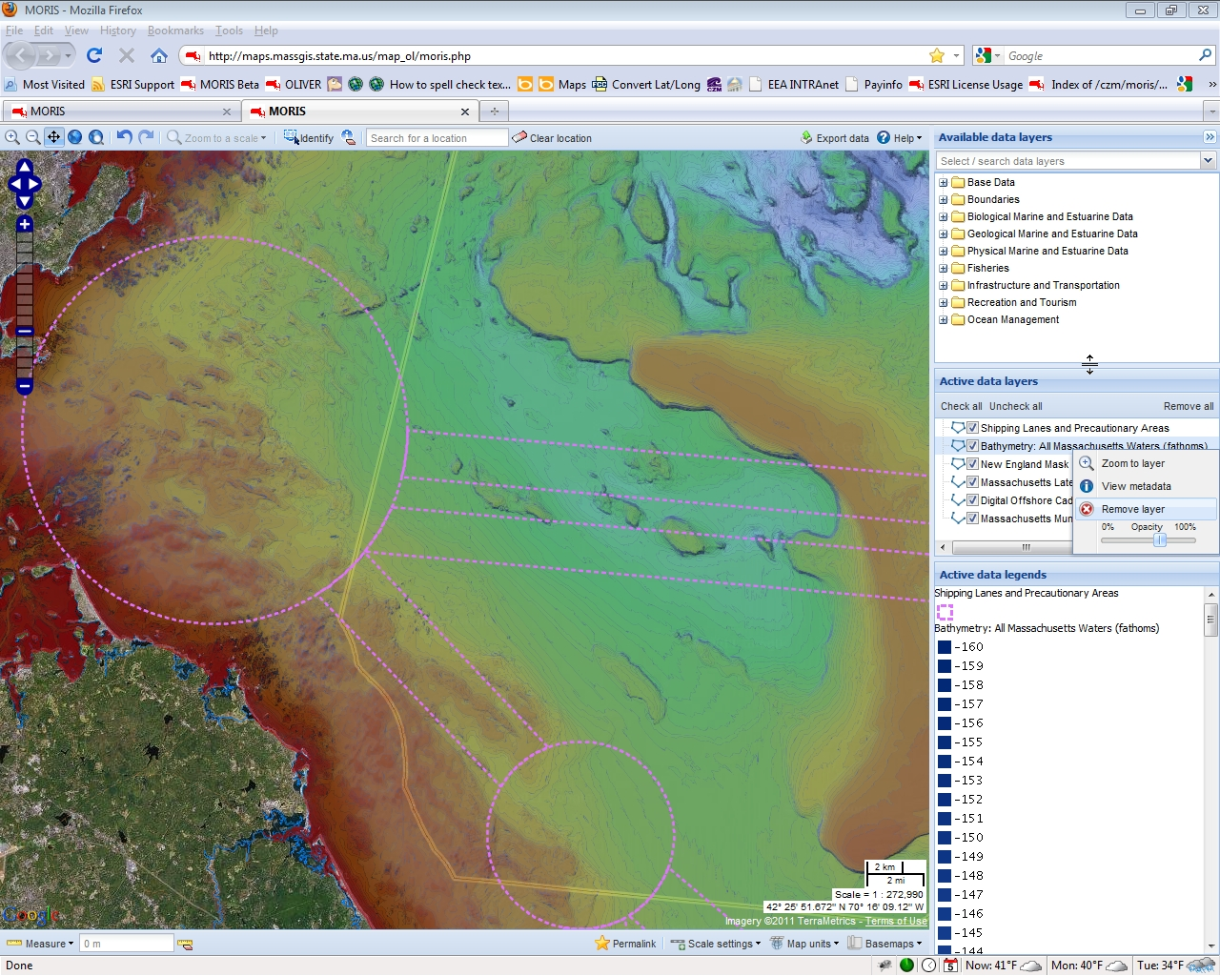
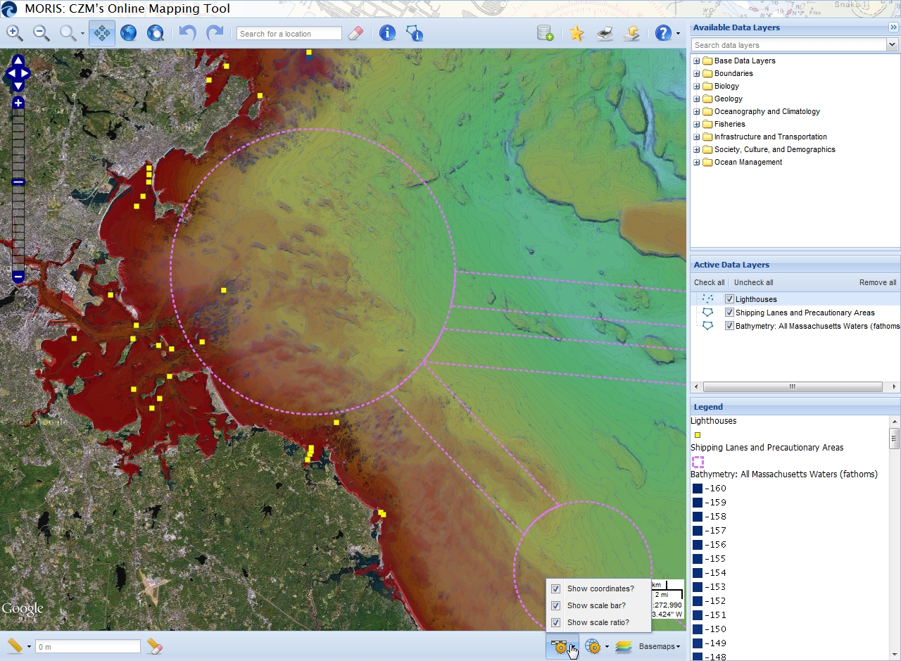
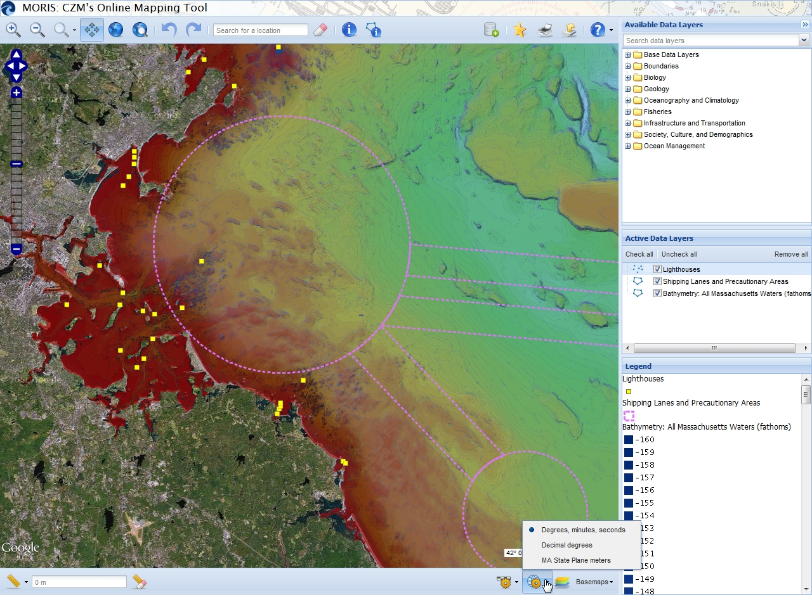
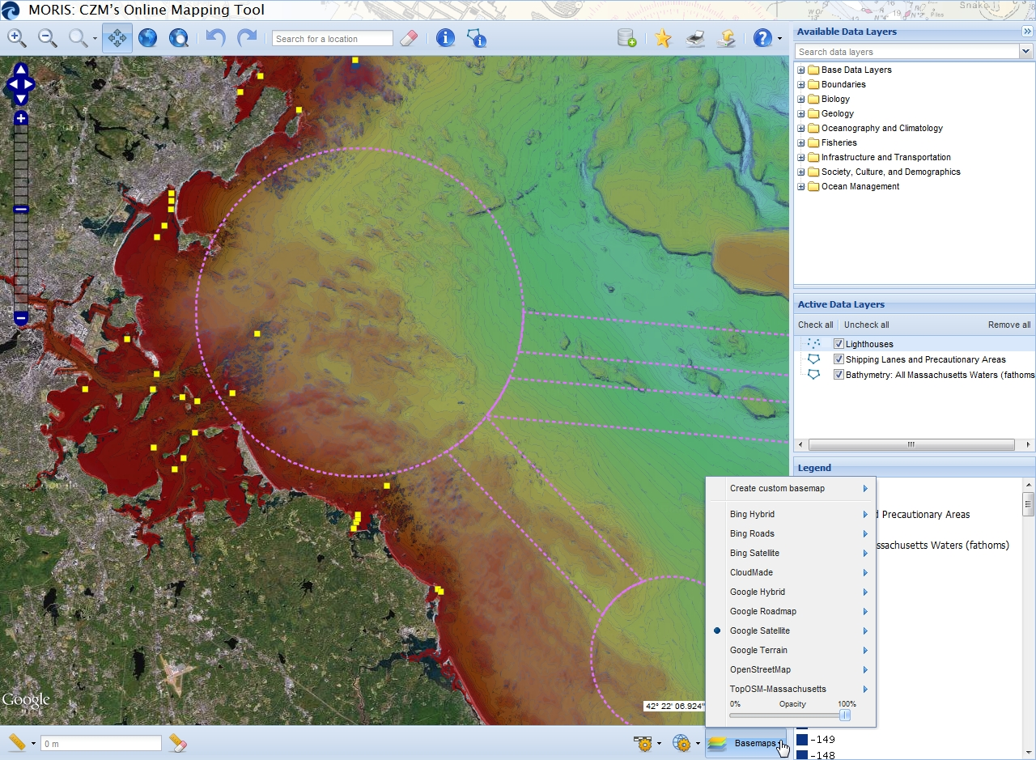
Customizing the Map
Windows: The “Available Data Layers,” “Active Data Layers,” and “Legend” windows may be minimized or resized. Click the arrows icon to minimize the three windows. To resize a window, move the mouse cursor over the edge of a window, hold down the mouse button, and drag the window edge to the desired height or width.
Scale settings: The coordinates, scale bar, and scale ratio in the lower right-hand corner of the map may be turned on or off. Click the “Scale settings” button to view a menu and click on or off the checkboxes to show or hide the coordinates, scale bar, and scale ratio.
Map units: When the cursor is over the map, the latitude and longitude of the cursor’s location are displayed in the lower right-hand corner of the map. To change the units of the latitude and longitude, click the “Map units” button to view a menu and select one of the listed options.
Basemaps: To change the basemap, click the “Basemaps” button to view a menu and select one of the listed options. The opacity of the current basemap may also be changed. Click the “Basemaps” button to view the menu, click the opacity slider, hold down the mouse button, and drag the slider to the desired opacity. This feature is not available for the custom basemap—the opacity of custom is controlled data layer by data layer in the “Active Data Layers” window. The metadata, or text documentation, for each basemap may also be viewed. To view the metadata of a basemap, click the “Basemaps” button to view the menu, move the mouse cursor over the basemap of interest, and click “View metadata.” A pop-up window will appear with the basemap’s metadata.
Back to Table of Contents

Slide 14
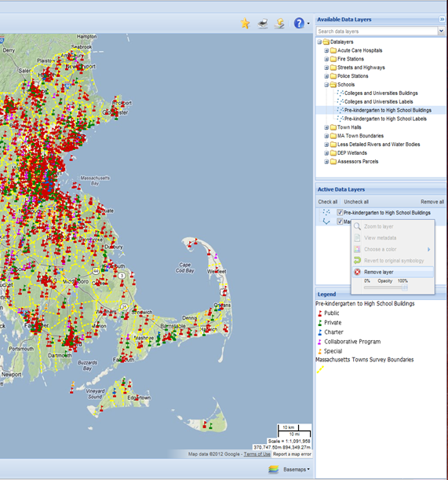
Removing Data Layers
To temporarily turn a data layer off, uncheck the box next to the data layer name in the “Active Data Layers” window. The “Uncheck all” button may be clicked to temporarily turn off all the active data layers. The legends of unchecked data layers will be removed from the “Legend” window.
To remove a data layer (which you should do if you are done with it), right-click the data layer name in the “Active Data Layers” window and select “Remove layer.” To remove more than one data layer, hold the Ctrl key on your keyboard to highlight multiple layer names, right-click, and select “Remove layer.” The “Remove all” button may also be clicked to remove all the active data layers.
Back to Table of Contents

Slide 15
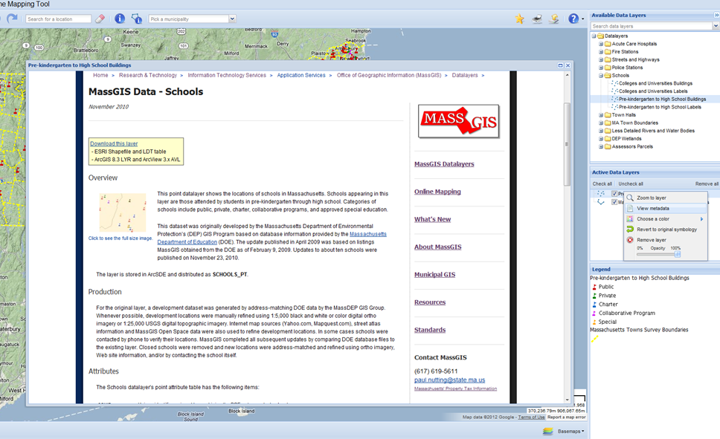
Viewing Metadata
Metadata is text documentation that describes a data layer. Virtually all available data layers have a metadata record. To view a data layer’s metadata, right-click a data layer name in the “Available Data Layers” window or “Active Data Layers” window and click “View metadata.” A pop-up window will appear with the data layer’s metadata from the MassGIS website.
Back to Table of Contents

Slide 16
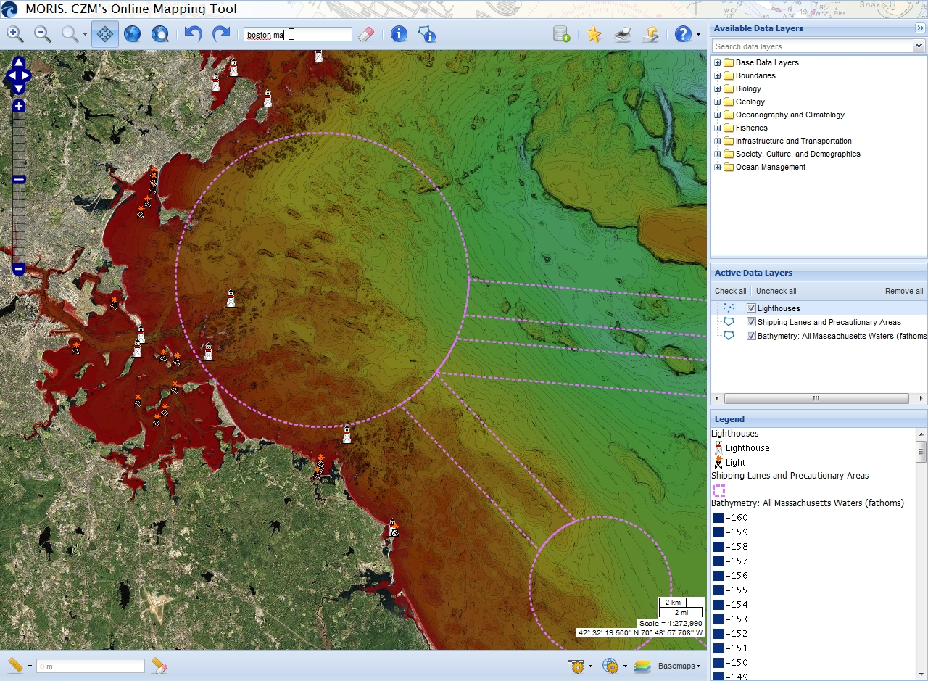
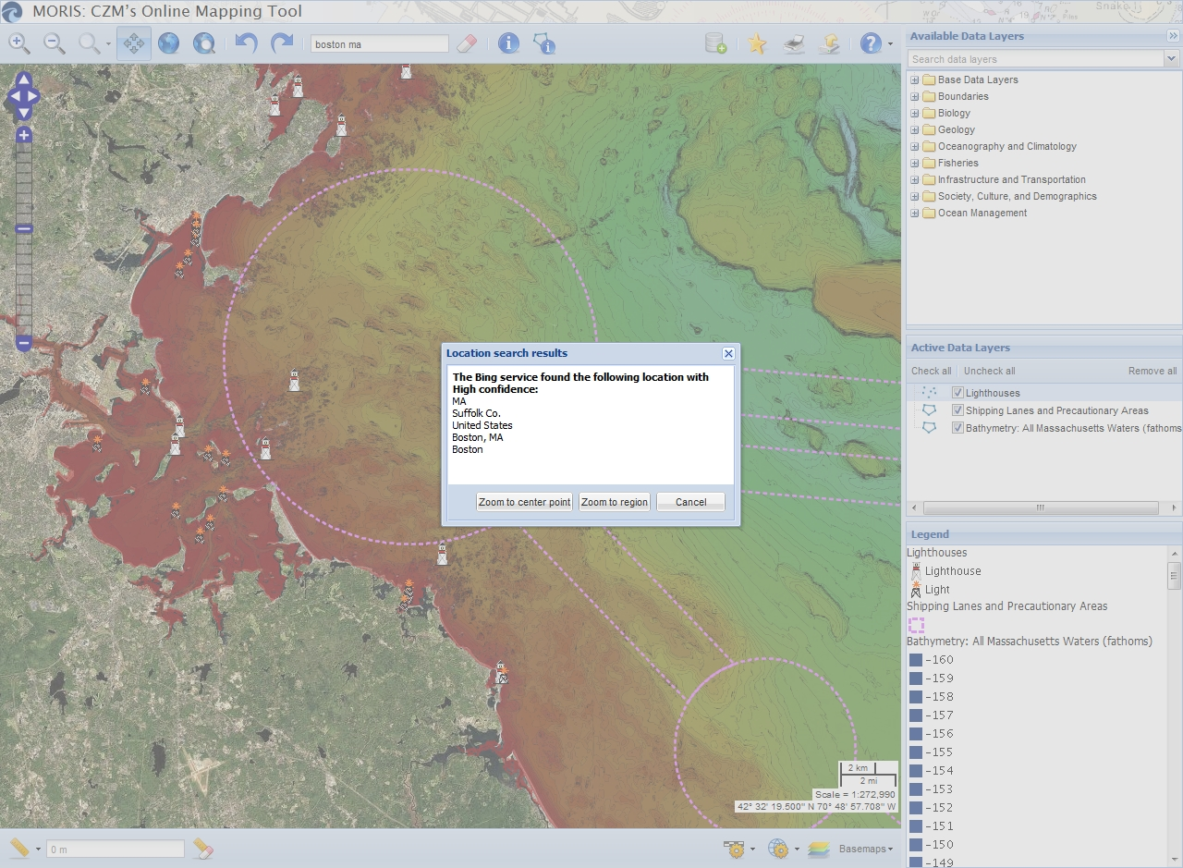
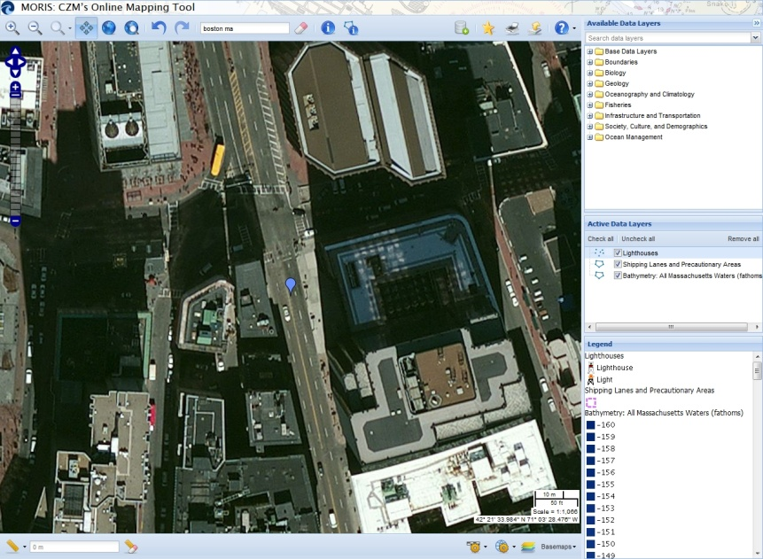
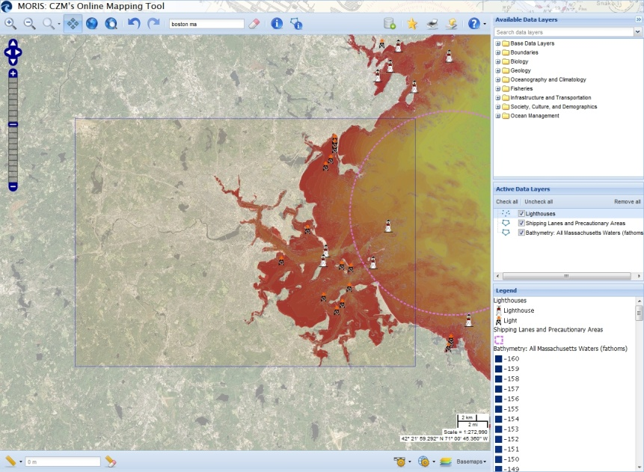

Searching for a Location
1. Type an address or location into the “Search for a location” box and press Enter to zoom to a location. The tool may be used to search a variety of locations, such as street addresses (please include a municipality or ZIP code), street intersections, municipalities, counties, coordinates, building names, and place names. This location search feature is provided by Microsoft Bing.
2. A pop-up window will appear with the location search results. Click “Zoom to center point” to zoom close to the results. A blue balloon is displayed at the center point of the location search results. Click “Zoom to region” to zoom to the region of the results. A blue rectangle is visible around the region of the search results.
3. Click the “Clear location” button to clear the location search results (the blue balloon or blue rectangle) from the map.
Zoom to center point
Zoom to region
Back to Table of Contents

Slide 17
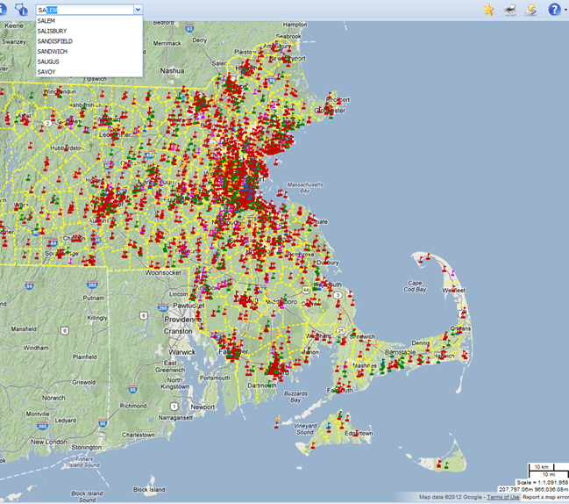
Searching for a Location (continued)
To zoom to a specific city or town, type a municipality name into the “Pick a town” box. You may also type just the first part of a town name. For example, to see a list of municipalities that begin with “Sa,” type “Sa” into the box. Click the town name of interest. The map will zoom to the extent of the selected municipality.
Back to Table of Contents

Slide 18
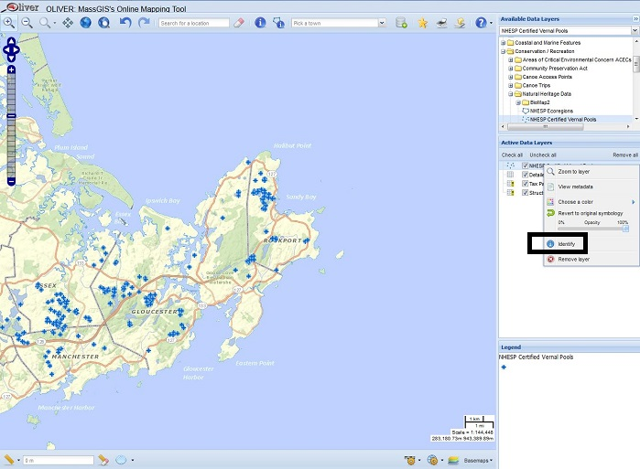
Identifying Features
Right-click on an eligible data layer in the Active Data Layers window and choose the "Identify" choice. If a layer is not eligible the "Identify" choice will be greyed out. Layers that are not eligible for identify include unchecked (not drawn) layers, out of scale layers (yellow exclamation mark), tilesets (with small boxes icon) or layers from external data sources.
Click on the map to identify features of the active data layer that intersect the location you clicked, or click on the map, hold down the mouse button, and drag to draw a box to identify features of active data layers located within the box. This box will appear red as you draw it.
Back to Table of Contents

Slide 19
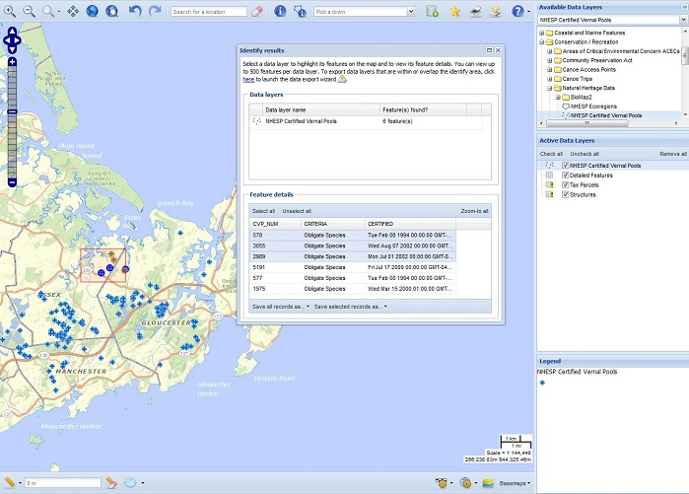
Identifying Features (continued)
3. A pop-up window will appear with the identify results. Data layers from external sources cannot be queried, so they will not be included in the results. You may view the attributes for up to 500 features per data layer. If identifying on a raster data layer, the raster’s cell value in the center of the identify box or polygon will be found. Please note that some data layers have scale dependencies and are only visible within certain scale ranges, such as less than 1:100,000. If a data layer has a scale dependency and the map is not within the appropriate scale range, then the data layer will not draw on the map, its icon in the “Active Data Layers” window will have a yellow exclamation point, and it cannot be identified. Please see the Help section on “Data Layers with Scale Dependencies” for more information on how to view data layers with scale dependencies. Once data layers with scale dependencies are visible, they may be queried.
Back to Table of Contents

Slide 20
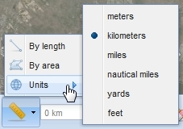
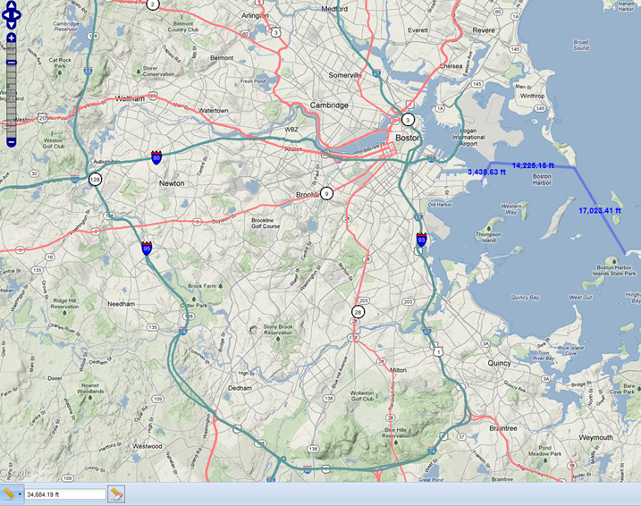
Measuring Length or Area
1. Click the “Measure” menu. The default is to measure length in meters and area in square meters. To change the unit of measurement, move the mouse cursor over “Units” to view a menu of measurement units options and click one of the listed units.
2. In the “Measure” menu, click “By length” to measure the length of a line, click on the map to draw vertices of the line, and double-click to finish drawing the line. Click “By area” to measure the area of a polygon, click on the map to draw vertices of the polygon, and double-click to finish drawing the polygon.
3. The results of the measurement will appear in the box next to the “Measure” menu. If measuring by length, the length of each line segment will be written on each segment on the map and the total length will be written in the results box.
4. Click the “Clear measurement” tool to clear the measured line or polygon from the map and to clear the distance or area from the measurement results box.
Back to Table of Contents

Slide 21
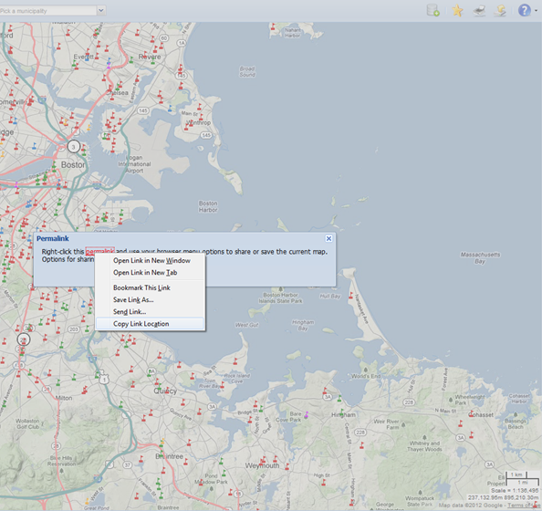
Bookmarking/Sharing a Map
1. To create a bookmark to launch the application with the current map settings (e.g., data layers, extent, etc.) enabled, click the “Permalink” tool.
2. Right-click the blue “permalink” and see the options. Options for sharing or saving vary among browsers. In Firefox “Copy Link Location” will copy the URL to the clipboard. “Bookmark This Link” will create a Firefox bookmark. In Internet Explorer “Copy shortcut” will copy the URL to the clipboard. “Add to favorites” will create an Internet Explorer favorite. In Google Chrome “Copy link address” will copy the URL to the clipboard. “Open link in new window” will open the map in a new browser window. You can then click the bookmark icon ( ) in the address bar to save the permalink map as a bookmark. In Safari “Copy Link” will copy the URL to the clipboard. “Add Link to Bookmarks” will create a Safari bookmark.
This URL may be saved as a bookmark in the web browser or shared with others in an email to launch the current map (includes the checked active data layers, along with their custom symbology and opacity settings, the map extent, the basemap, and the map units, but not external data layers).
Please note: Some software programs, such as Microsoft Outlook, limit the number of characters allowed in a URL. If the permalink URL exceeds the maximum allowed length, the link will not open automatically when clicked. Copy and paste the URL into a web browser to open it.
Back to Table of Contents

Slide 22
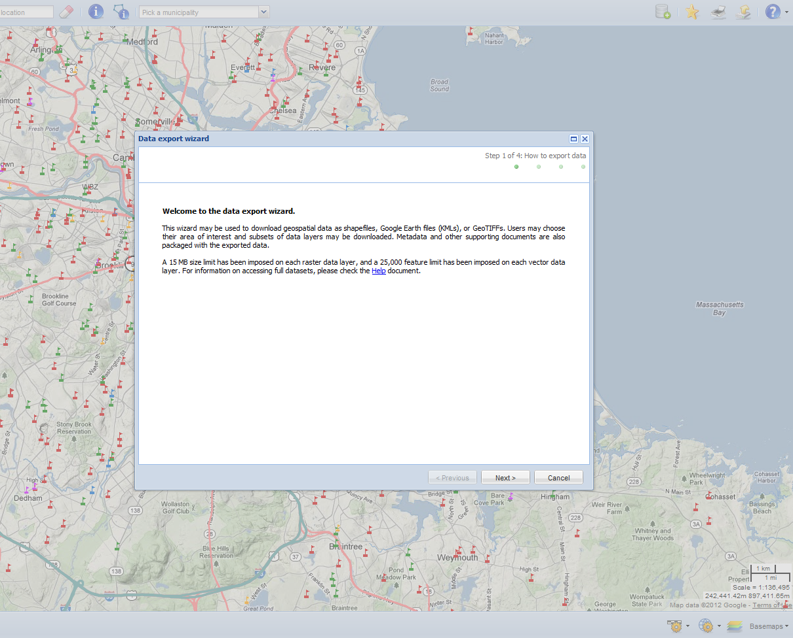
Downloading Data
1. Click the “Data export wizard” tool.
2. The data export wizard will appear in a pop-up window. Read the welcome paragraph and click “Next” to continue.
Back to Table of Contents

Slide 23
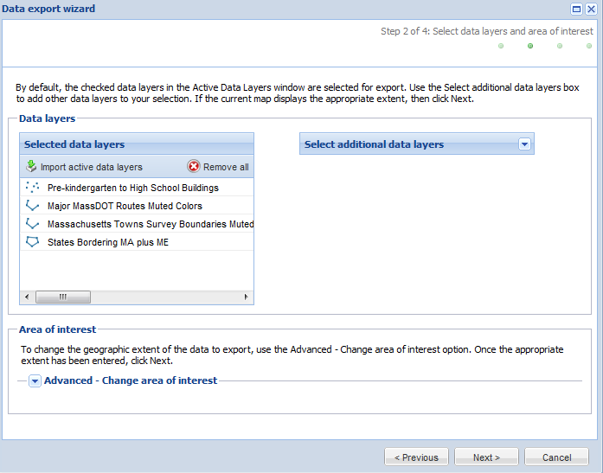
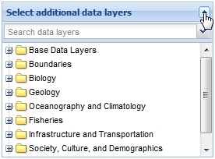
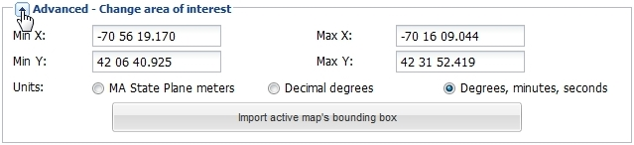
Downloading Data (continued)
3. By default, the checked data layers in the “Active Data Layers” window will appear in the “Selected data layers” table. External data layers cannot be exported. Individual data layers can be removed from this list by clicking the data layer name in the “Data layers of interest” table, right-clicking, and selecting “Remove layer(s).” To remove more than one data layer, hold the Shift or Ctrl key on your keyboard to highlight multiple rows, right-click, and select “Remove layer(s).” To remove all data layers, click “Remove all.” Additional data layers not present on the current map can be added by using the “Select additional data layers” drop-down menu. Click a data layer name to add it to the “Selected data layers” table. To export all the data layers in a folder, right-click a folder name and select “Add folder.” Only folders at the bottom of the folder hierarchy may be added.
4. If you want to export data that are within or overlap the current map window extent, click “Next.” If you want to change the area of interest, click “Advanced - Change area of interest.” If changing the area of interest, select the units you would like to use (i.e., Massachusetts State Plane meters, decimal degrees, or degrees, minutes, and seconds). Then enter the minimum X, minimum Y, maximum X, and maximum Y coordinates you want to use to define your area of interest. If you prefer to go back to the original extent instead, select the “Import active map’s bounding box” button to import the current map extent. Click “Next” to continue.
Back to Table of Contents

Slide 24
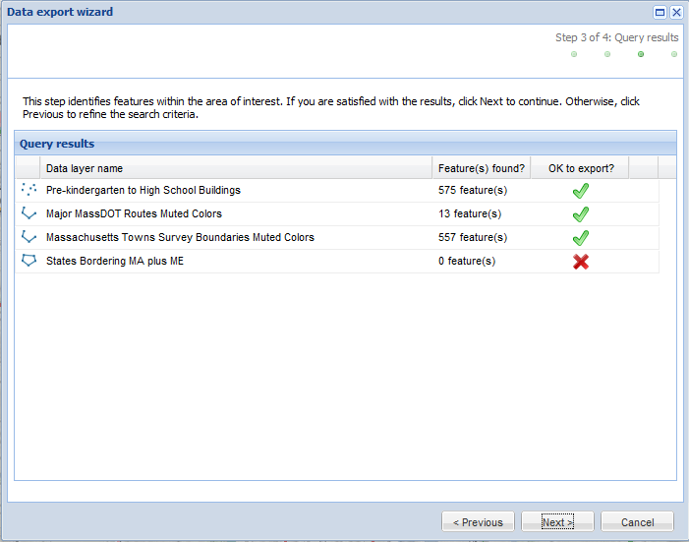
Downloading Data (continued)
5. The “Query results” table lists the data layers for export and the number of features found for each data layer within your area of interest. A green check mark indicates that the data layer is okay to export. A red “X” indicates that the data layer will not download because zero features or greater than the maximum number of features allowed for download were found within your area of interest, or the file size of the raster data layer for your area of interest is too large. Click “Next” to proceed.
Back to Table of Contents

Slide 25
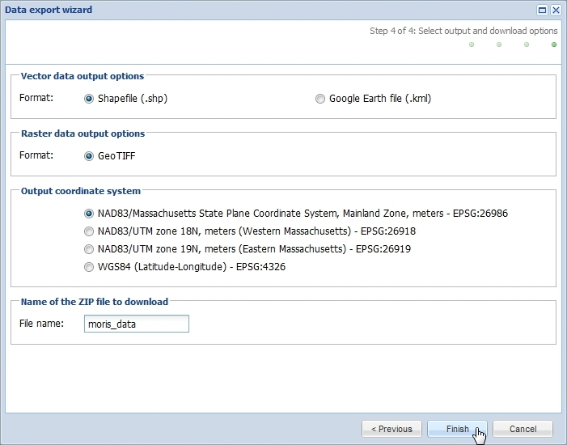
Downloading Data (continued)
6. Select your preferred data output. The default format is shapefile (.shp) for vector data. Also available is Google Earth file (.kml). For raster data, the GeoTIFF radio button will be selected by default since this is the only raster format available at this time.
7. If downloading the vector data as shapefiles, select the output coordinate system for the data you are going to export. The default system is NAD83/Massachusetts State Plane Coordinate System, Mainland Zone, meters - EPSG:26986. Currently, rasters can only be downloaded in NAD83/Massachusetts State Plane Coordinate System, Mainland Zone, meters - EPSG:26986.
8. The exported data and associated files (e.g., HTML metadata file, XML metadata file, symbology file, etc.) will be downloaded in a ZIP file. Enter a file name (with no spaces) for the ZIP file to download.
9. Click “Finish.” A pop-up window will appear. Click the blue “here” and follow your browser instructions for saving the file. Close the pop-up window once you have saved the exported data.
Back to Table of Contents

Slide 26
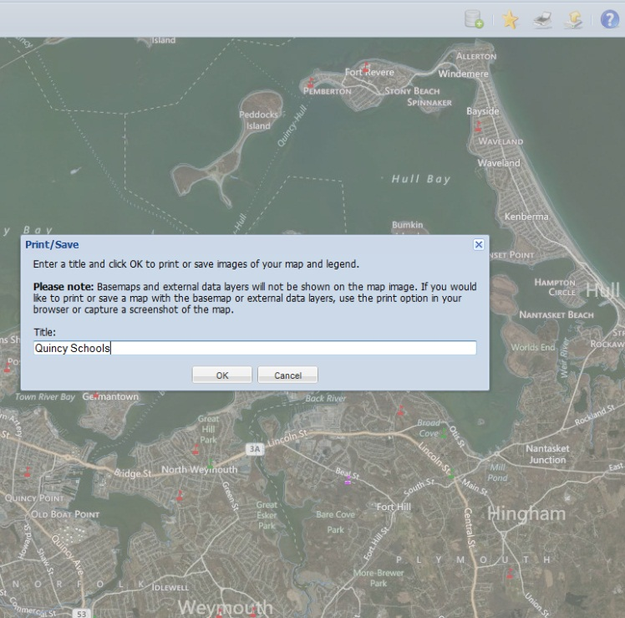
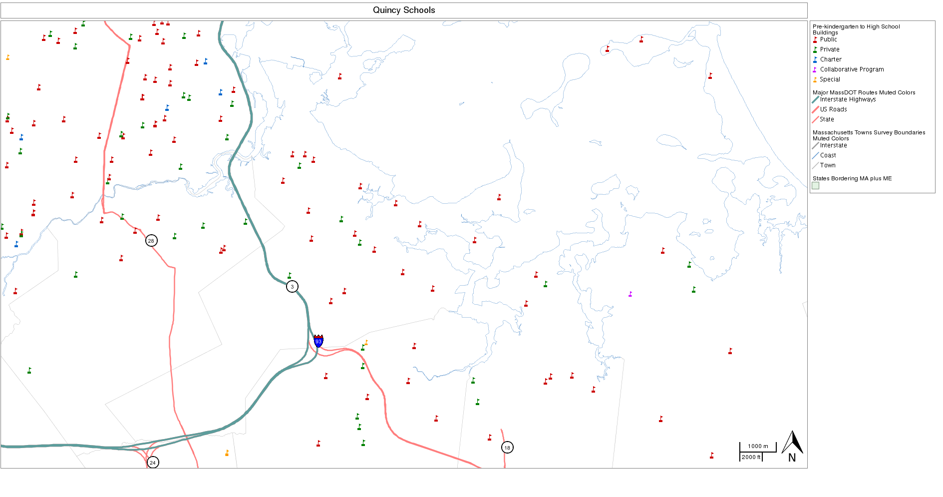
Printing and Saving a Map Image
1. Click the “Print or save your map and legend” button.
2. A pop-up window will appear. Enter a title for the map and click “OK.” Please note that due to licensing issues, basemaps and external data layers will not be shown on the map image. If you would like to print or save a map with the basemap or external data layers, use the print option in your browser or capture a screenshot of the map.
3. Your map will be assembled and a new pop-up window will appear. Click the blue “here” to open a new window containing your map and legend as separate images. You can then either right-click each image and save them locally or use the browser print option to print the entire map.
Please note: If you would to print or save a map with the basemap or external data layers, you may use the print option in your browser or capture a screenshot of the map. Printing from the browser is possible using the “File” menu and “Print” option. Use “Print Preview” to see the expected result. Choosing landscape orientation and setting the scale so that the map and legend fit on the printed page will work best. The three windows to the right of the map may be adjusted in size to, for example, make the legend area larger.
To insert an image of the map into other documents, capture a screenshot of the map. Press and hold Alt then press Print Screen (or PrtScn) on your keyboard to copy an image of your computer’s active window display to your clipboard. This image can be pasted into another software program, such as Microsoft Word.
An external basemap is seen online,
but when printed, the external basemap will not appear
Back to Table of Contents

Slide 27
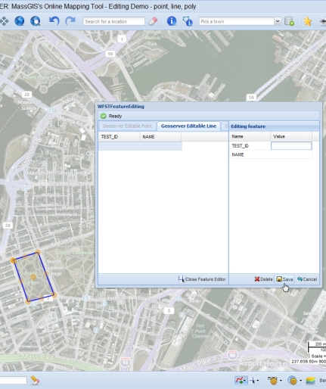
Editing Data
Some versions of MuniMapper allow points, lines, and polygons to be edited live. That version is something that needs to be arranged for, and will ask for a username and password to verify permission to perform edits.
Drawing New Features
1. Click the “Draw New Feature” tool to view a menu of data layers that may be edited.
2. Select one of the listed data layers to which to add a feature (there may be one or more data layer choices).
3. Click on the map to start drawing the feature.
4. In some applications snapping to features and splitting (of lines) may be enabled. In that case, a prompt will ask you to draw a box to indicate the snapping area.
5. If drawing a point feature, click once on the map to draw the new feature. If drawing a line or polygon feature, click more than once on the map to mark out the vertices of your line or polygon and double- click to finish drawing. Once you have finished drawing your new feature, the attribute editing window (titled WFSTFeatureEditing) will appear.
6. If snapping or splitting is available, it is configured specifically for each application. Consult the more detailed instructions provided. As a general note, snapping can happen to more than one data layer, including the data layer being edited. Snapping will occur even if the data layer being snapped to is not drawn on the map. Snapping will occur to both lines and vertices. However, features that are selected by this drawn rectangle are used in their entirety. Currently it is possible to split only lines with lines. When approaching a data layer feature to which it is possible to snap you will sense a bit of “stickiness”—the vertex will seem to jump slightly to match up to the line or vertex.
7. Enter values for the attribute fields. Click the “Save” button in the lower right of the attribute editing window when done. If you wish to cancel adding a feature, click the “Cancel” button in the lower right of the attribute editing window.
8. The new feature will immediately appear on the map.
Back to Table of Contents

Slide 28
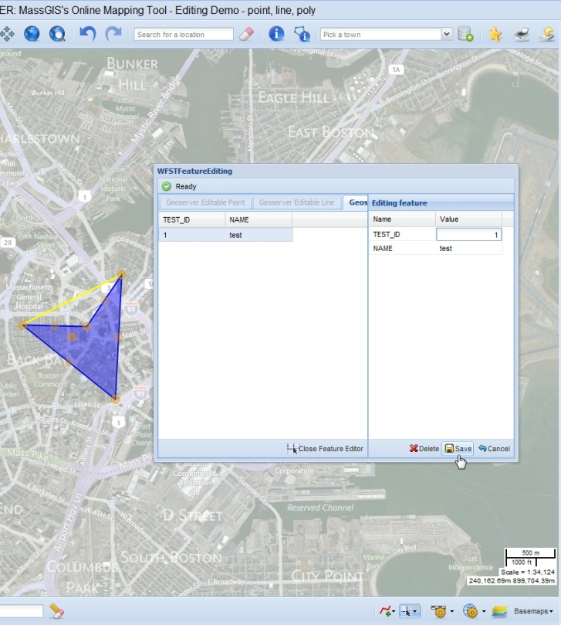
Editing Data (continued)
Editing Existing Features
1. Click the “Edit Existing Feature” tool to view a menu of data layers that may be edited.
2. Select one of the listed data layers to edit from the menu (there may be one or more data layer choices).
3. Draw a box on the map to select a feature to edit. Features within or overlapping that box will be selected. You may zoom in or out while features are selected.
4. If more than one feature was selected, choose one feature within the attribute editing window. (Only one feature may be edited at a time.) The selected feature will turn blue and have orange vertices.
5. You may move the feature, change its shape, or change its attributes. To move the feature, click on the vertex (orange dot) closest to the center of the feature and drag. You should see the blue feature with orange vertices move, while the original feature stays. If you decide to save, the original feature will disappear. To reshape the feature, click on a vertex (orange dot) and drag it. You will see the blue feature change shape. To add vertices, click on a vertex that is not on a corner and drag it slightly. A new vertex to both sides will be created.
6. If drawing a point feature, after one click the attribute editing window (titled WFSTFeatureEditing) will appear. If drawing a line or polygon feature, click more than once on the map to mark out the vertices of your line or polygon and double-click to finish drawing.
7. Change any values for the attribute fields. Click the “Save” button in the lower right of the attribute editing window when done. If you wish to cancel editing a feature, click the “Cancel” button in the lower right of the attribute editing window.
8. The edited feature will immediately appear on the map.
The current editing attributes system is basic. Enhancements such as mandatory fields, restricted fields and dropdown values are planned.
Comment Tool
There is a “Comment” tool option that allows a point to be entered into a data layer with attributes. The points may only be entered, not edited.
Back to Table of Contents

Slide 29
Using MuniMapper on a Mac
This user guide was written using a Windows PC. Below are some tips for using MORIS on a Mac.
Right-Clicking Some of the tools and menus are accessed by right-clicking (e.g., to zoom to the extent of a data layer, right-click the data layer name in the “Active Data Layers” window and select “Zoom to layer”). If your Mac mouse has one button, you may right-click by holding down the Control key and then clicking with the mouse.
Highlighting Multiple Rows To highlight multiple rows, hold the Shift or Command key on your keyboard and then click the rows of interest. After identifying features, users may highlight multiple rows in the “Feature details” table in the “Identify results” pop-up window. Users may also remove more than one data layer from the “Selected data layers” table in the “Data export wizard” by highlighting multiple rows.
Saving a Map Image To insert an image of the map into other documents, capture a screenshot of the map. Click Command-Shift-4 on your keyboard, then the space bar, then click a window to save an image file of the selected window on the desktop. Click Command-Control-Shift-4 on your keyboard, then the space bar, then click a window to copy an image of the selected window to your clipboard. This image can be pasted into another software program, such as Microsoft Word.
Back to Table of Contents

Slide 30
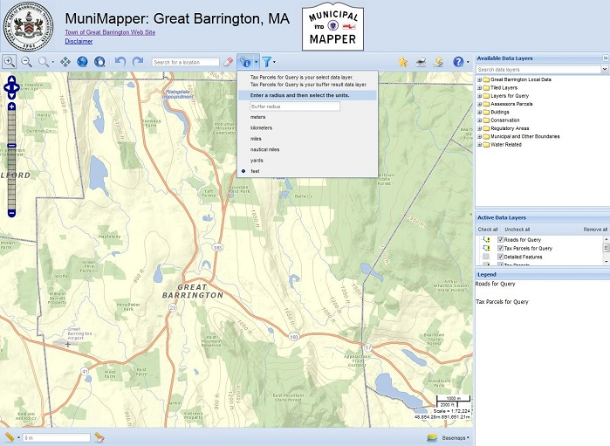
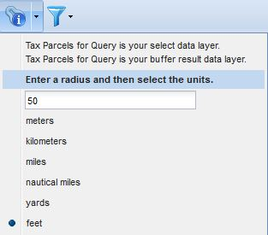
How to Use the Abutters List Tool:
NOTE: The abutter list produced by the abutters list tool is not a certified list; a certified list can only be provided by the municipality.
Click on the button that looks like an "i" with a small buffer around it and dropdown to see the units.
2. Fill in the number of units and choose a type of unit. For example, 50 feet or .5 mile.
Back to Table of Contents

Slide 31
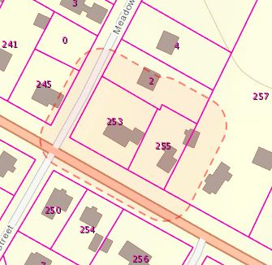
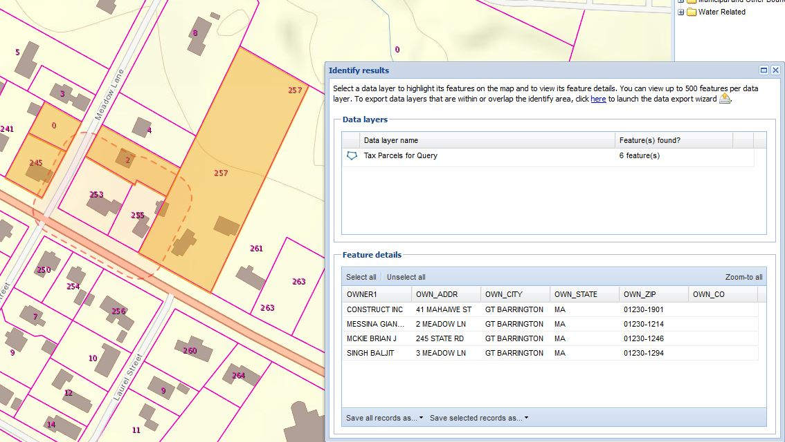
How to Use the Abutters List Tool (cont.):
3. With the mouse, draw a box to include one or more parcels to buffer for an abutters list. Currently up to 3 parcels may be selected. The parcels will be selected and buffered using the distance specified. A dotted orange line will draw on the map to show the buffer line.
4. Currently parcels of POLY_TYPE="ROW" are automatically dropped from the initial selection (a message will indicate if any have been dropped). 5. After the buffer has been calculated, the abutters parcels will be selected. Currently parcels of POLY_TYPE="ROW" or POLY_TYPE="PRIV_ROW" will be dropped from the buffer results selection (the final abutters list) (a message will indicate if any have been dropped).
Back to Table of Contents

Slide 32
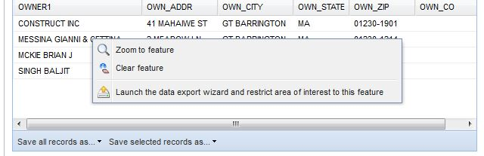
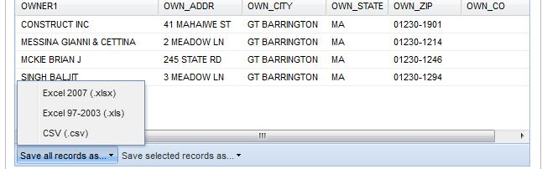
How to Use the Abutters List Tool (cont.):
5. If too many abutters list parcels are been selected, right click a row and choose "Clear feature".
6. At the bottom left of the table choose "Save all records as.." dropdown to save the abutters list information as an Excel spreadsheet or CSV text file.
Back to Table of Contents

Slide 33
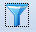
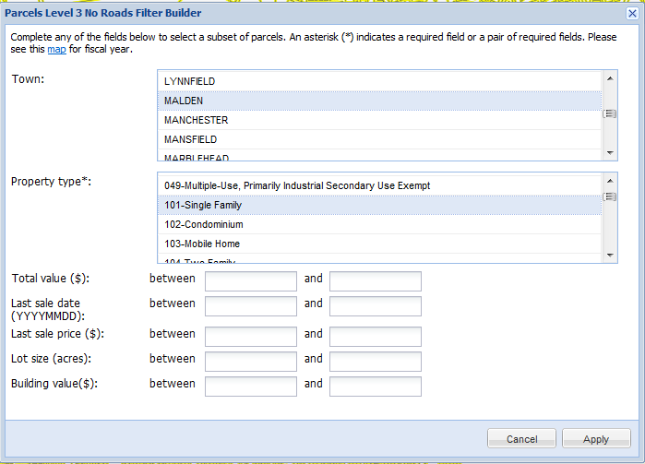
How to Use the Parcel Data Filter Tool:
The Muni Mapper allows the user to filter the parcel data by town or multiple towns, property type, total value (land + bldg.), bldg. value, last sale date, last sale price and lot size. Once the database is filtered, all of the candidates meeting your criteria will be displayed along with all of the assessors data attributes, not just the filter options.
With consultation with MassGIS, the filter tool can be customized to use any of the fields in the parcel database or for any of the other layers.
The Filter will take your geographic area into account. If you wish to query parcels that are within the map extent you are at, just start using the Filter Builder tool and under Town select ALL. However, if you wish to filter parcels by a subarea as well, first zoom in to your area of interest using any of the zoom methods previously described.
Once the map shows your geographic area of interest click on the Filter tool which looks like a funnel.
Examine the dialog box for the filter tool:
Back to Table of Contents

Slide 34
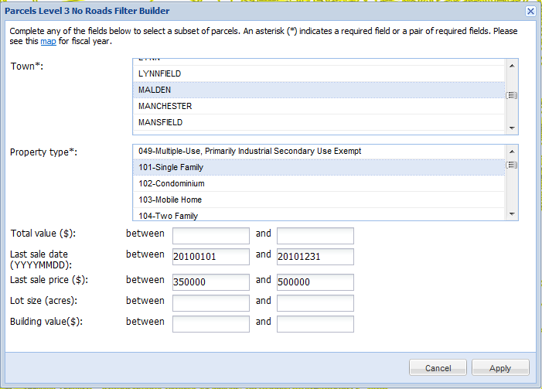
How to Use the Parcel Data Filter Tool (cont.):
Currently it has been set up so that Town and property type are required (note the asterisk * which is the normal indication of a required item on the web) and all of the other fields are optional. You’ll need to be familiar with the Property type use codes for your particular town(s). The Dept. of Revenue maintains a list of standardized codes at http://www.mass.gov/dor/docs/dls/bla/classificationcodebook.pdf However, some towns use these codes, or variations on these codes, or their own. In many towns (like Malden), use codes are accompanied by descriptive text.
More than one Town or Property type may be selected. Just hold down the shift key to select an additional choice. Just remember the more you choose, the longer the process will take to return your results. 101 is normally the code for single family homes and 102 or a similar variation is a condominium.
In this example I will use the “Pick a city/town” dropdown to zoom directly to Malden and then search for single family properties sold between Jan. 1, 2010 and Dec. 31, 2010, with a sale price of between $350,000 and $500,000. Once your query parameters are set, click the “Apply” button.
Back to Table of Contents

Slide 35
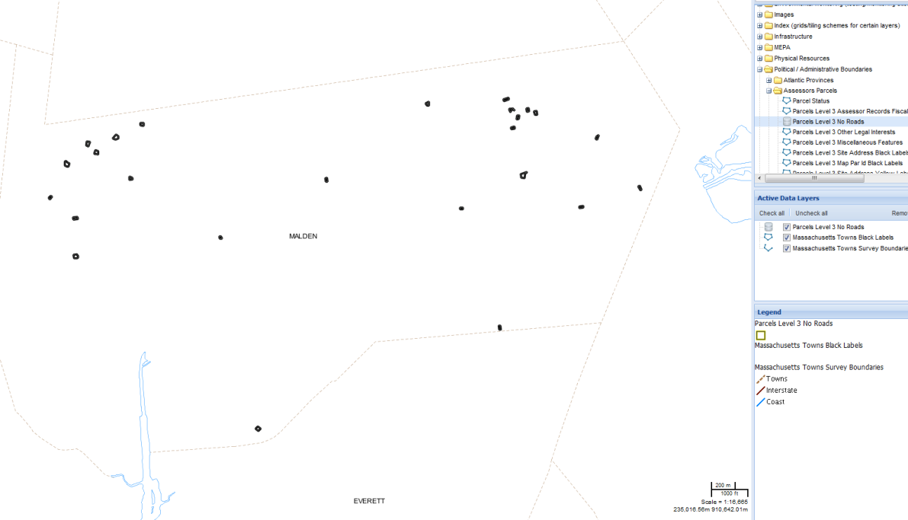
How to Use the Parcel Data Filter Tool (cont.):
Then 2 things will happen:
The parcels that match your filter query will draw on the map. Note – if you pan or zoom the map the parcels will stay (no additional parcels will appear until a new filter is done). There is no limit to the amount of parcels that can draw. However, there is a 500 record limit to the number of tabular records that will be returned.
An Identify results window will appear showing the number of parcels that matched your filter query.
Back to Table of Contents

Slide 36
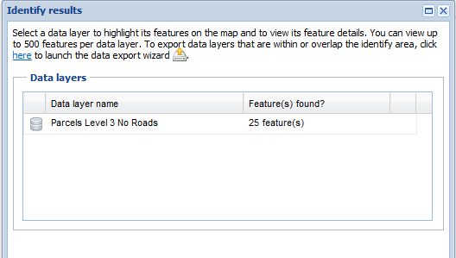
How to Use the Parcel Data Filter Tool (cont.):
.
The Filter Builder box can be closed at any time to better see the map and reopened by clicking on the Filter button
If the number of parcels meeting your criteria is less than 500 you can then get a table of information for those parcels,
which includes all of the fields in the assessor’s database. Click on the row with the name
“Parcels Level 3 No Roads”. Underneath a “Feature details” section will appear:
Back to Table of Contents

Slide 37

How to Use the Parcel Data Filter Tool (cont.):
This window and columns may be resized. Columns may be dropped and column values can be sorted ascending or descending by using the dropdown that appears when you hover over the field names. When the table opens, the parcels on the map are highlighted in orange. If a row or rows in the table are selected in blue, the corresponding parcels on the map are highlighted in blue. Parcels on the map may also be clicked blue and will be highlighted in the table. Hold down the shift key to select multiple rows or parcels.
To do a new query just change your parameters in the Filter Builder dialog and click the “Apply” button again. The Filter tool always keeps your last query, so the Filter Builder box can be closed at any time and reopened by clicking on the Filter button .
Back to Table of Contents

Slide 38
How to Use the Parcel Data Filter Tool (cont.):
It is possible to bookmark your query map or send the URL to another person by using the Permalink tool .
Click the yellow star and follow the instructions. (Instructions are slightly different for different browsers.)
You can print your query map and the printout will contain only the dots on the map that match the query filter.
You can extract the data of your query and the resulting shapefile or KML will only contain the parcels that match the query filter.
If exported as a shapefile, one of files contained in the export will have a .dbf extension. This file is the assessors table of your selected parcels. While you do need GIS software to view a shapefile, you can view the .dbf in Excel.
Back to Table of Contents

Slide 39
Problems? Questions? Comments?
Troubleshooting If the map does not initially load in Internet Explorer, go to the “Tools” menu and click “Internet Options.” Click on the “Security” tab and click the button “Default level.” Click the “Apply” button and the “OK” button and then reload the MuniMapper page.
Errors Drawing Data Layers If there is an error drawing a data layer, the data layer’s icon in the “Active Data Layers” window will have a red exclamation point. This red exclamation point indicates that the data layer is currently unavailable; this may be due to an internet connection or a web services problem. Changing the map extent (e.g., panning), adding data layers, etc., will cause the data link to be refreshed. If this connection is restored, the red exclamation point will go away.
Please Report Problems and Give Feedback To assist in the maintenance of these data, users are encouraged to report errors or omissions. To report a data error, please contact the MassGIS Outreach Coordinator at paul.nutting@state.ma.us. We would also appreciate feedback, so please let us know of any suggested enhancements, bugs you experience, or other comments you may have. To view a list of known problems or to check and see if a bug you experienced is documented, please see the list of issues on the MORIS Google Code site.
Interested in learning more? If you are interested in learning more about the technology behind MuniMapper, please view the MORIS Developers Documentation available at http://maps.massgis.state.ma.us/map_ol/moris_developers_documentation.htm.
Terms of Use:
By using OLIVER you are also bound by Google's Terms of Service. OLIVER's privacy policy includes Google's privacy policy.
Back to Table of Contents

